Slide 2
Reports with Nuix &
Tableau Public

Slide 3
Today’s Program
Reports with Nuix & Tableau Public
Data in Nuix
Purposeful Processing
Data Preparation & Enrichment
Integration with Tableau (Practical Demonstration)
Data in Tableau (or really any platform)
Summary & Group Discussion

Slide 4

End to End
Today’s journey
Raw Data
Normalized Data
Schema Optimized Data
Killer Reports, Visualizations & Dashboards

Slide 5
Data in Nuix
A natural data lake
Normalization of unstructured, semi-structured and structured data
Traversal methods and back end indices are not tightly coupled
Compelling aggregation and correlation capabilities
Indices provide efficient, scalable and sustainable access to data

Slide 6
Purposeful Processing
Sledgehammer or scalpel?
Process everything and sort it out later
Comprehensive w/ complexity of scale
Or
Targeted, selective extraction & in-flight schema application
Succinct w/ complexity of precision

Slide 7
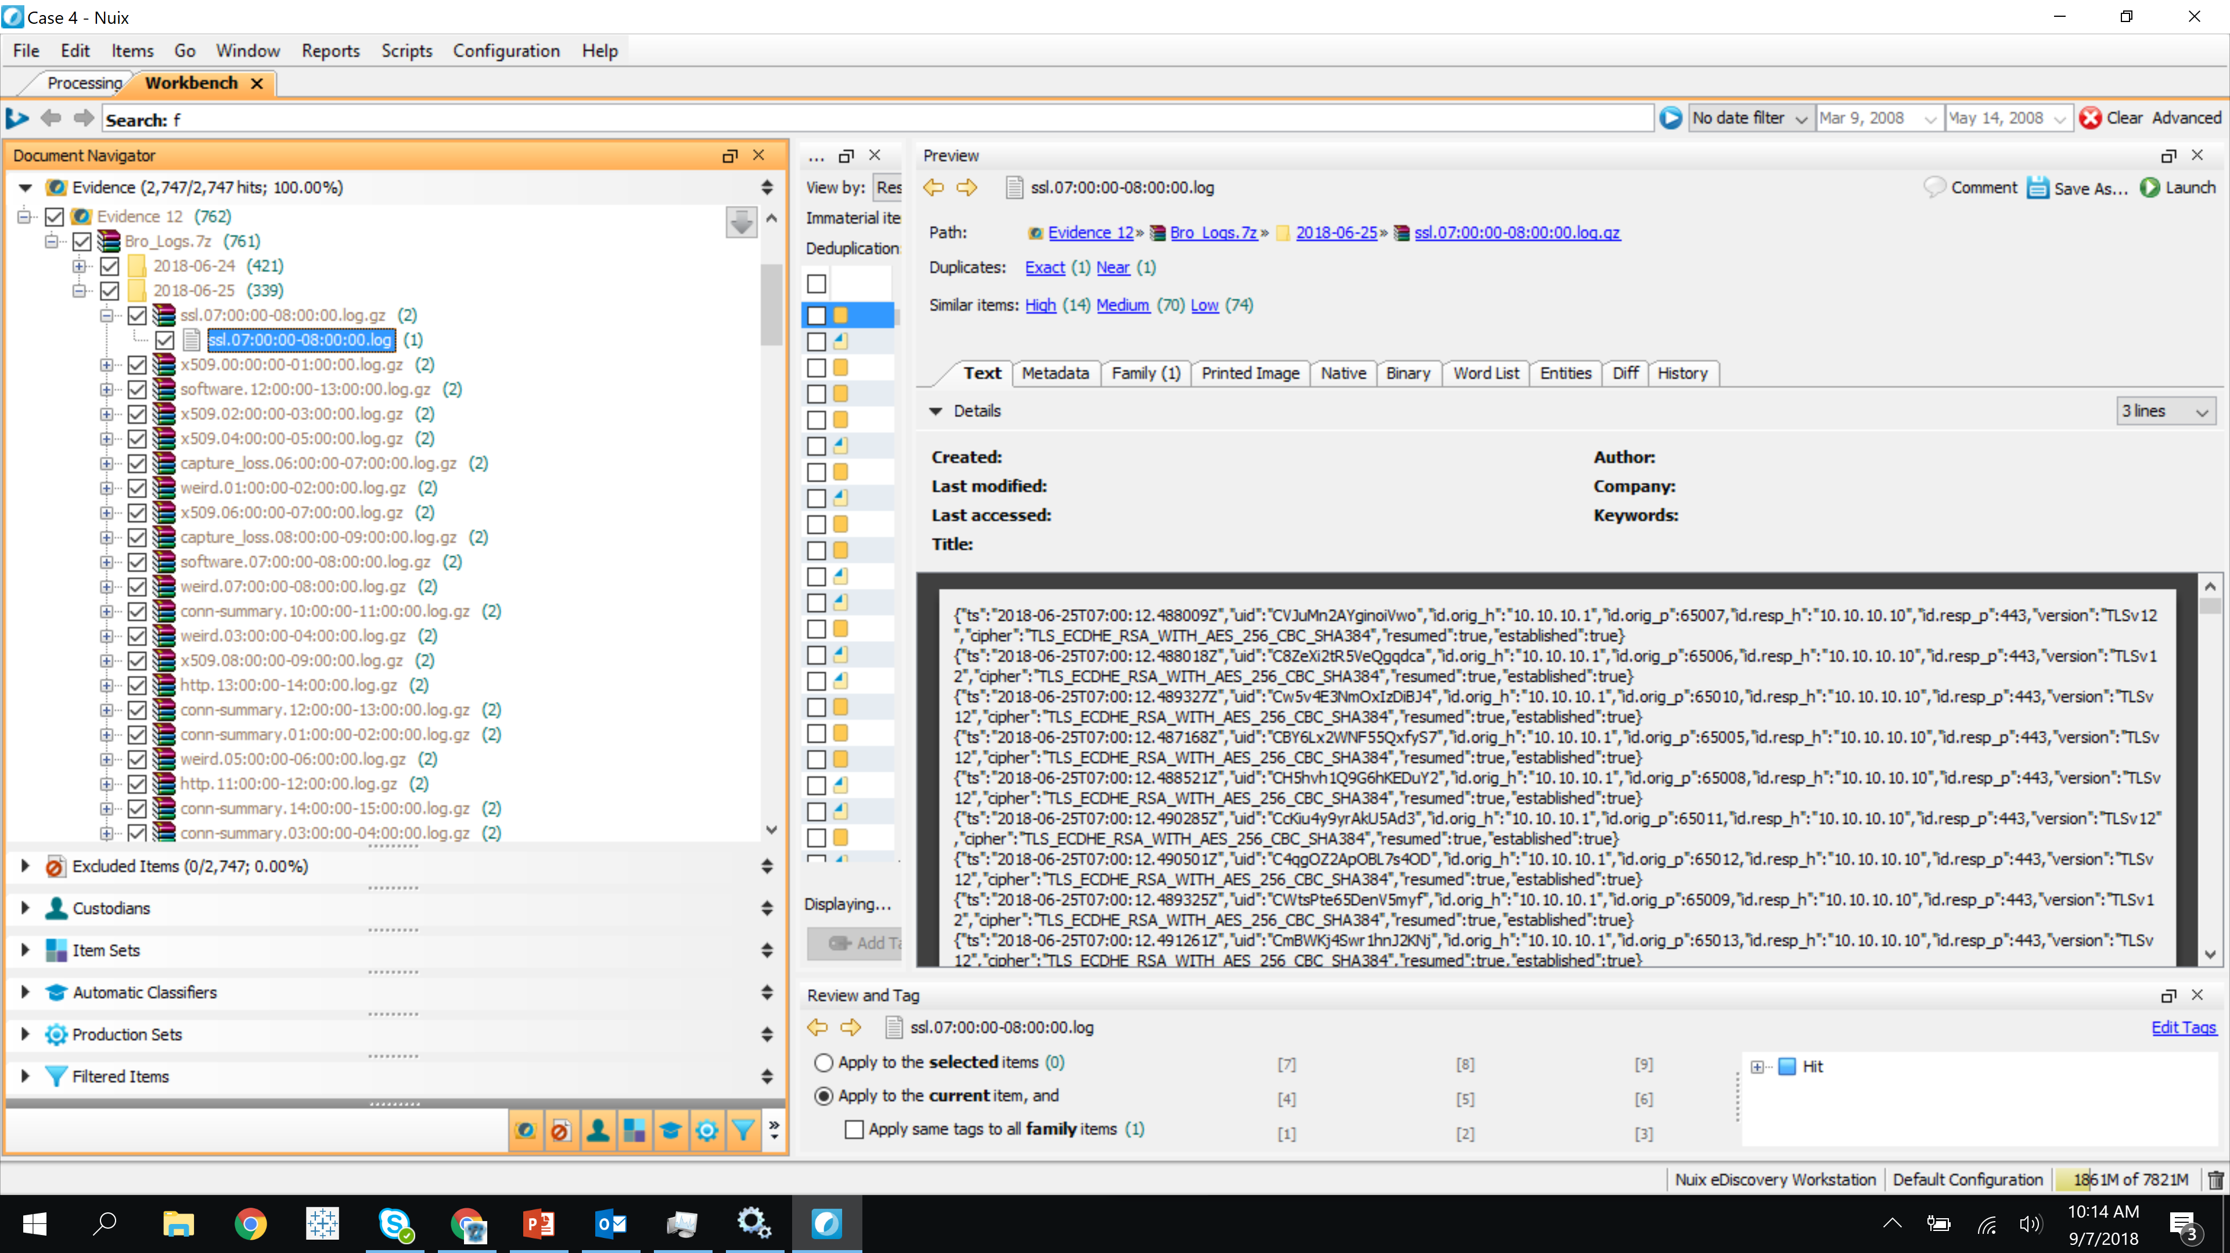
Purposeful Processing
Our is not to reason why
Given:
A single 7z file
7z contains multiple GZIP files
GZIPs contains multiple LOGs
LOGs contain multiple JSON blobs, 1 per line

Slide 8
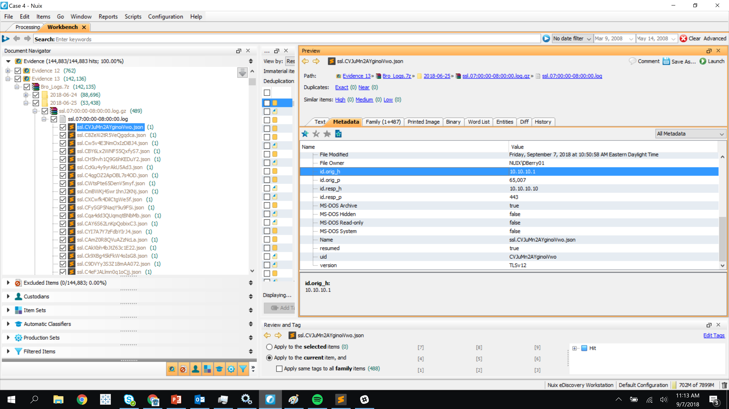
Purposeful Processing
Sledgehammer or scalpel? An Example!
With a worker side script:
Each valid line of JSON was provisioned as an child item of the LOG file
Invalid JSON blobs were handled, logged and gracefully recovered from
The JSON was parsed and each key:value pair was set as strongly typed properties

Slide 9
Side Note
Big oddly shaped piles of unstructured data everywhere I look
Data Remediation
String Scrubbing, Field Typing, etc…
80/20 Rule
Iteration
Transparency is key
Include iterative remediation data in reporting

Slide 10
Data Preparation & Enrichment
Dress appropriately for the journey
Evaluate your source data
Define your “perfect world” reports, visualizations and dashboards
Extrapolate an optimal schema for your “perfect world” reports
Map specific data from point A to B

Slide 11
Practical Demonstration

Slide 12
Dependencies
What’s under the hood?
Nuix REST API
Tableau Public
Some boiler plate HTML
Dash of JavaScript

Slide 13
End to End
Let’s take a step back…
Raw Data
Normalized Data
Schema Optimized Data
Killer Reports, Visualizations & Dashboards

Slide 14
Let’s Walk Through It

Slide 15
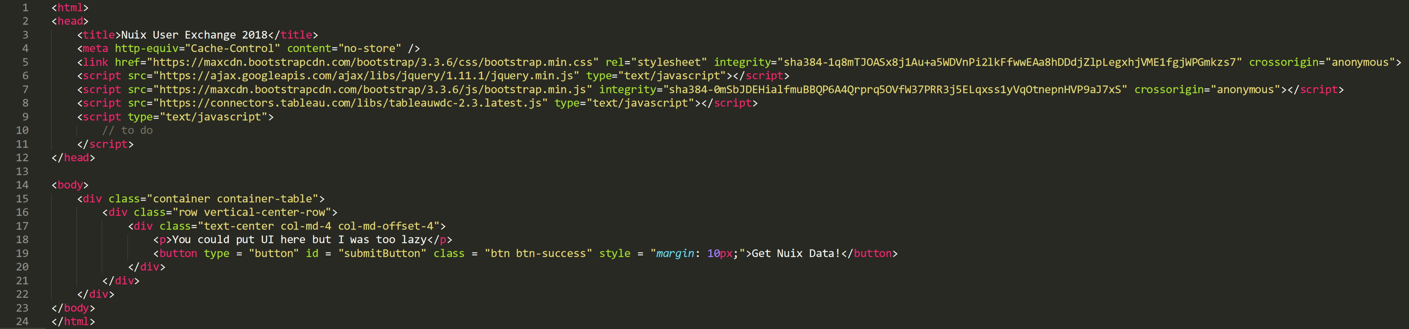
Boilerplate HTML
Building the bridge

Slide 16
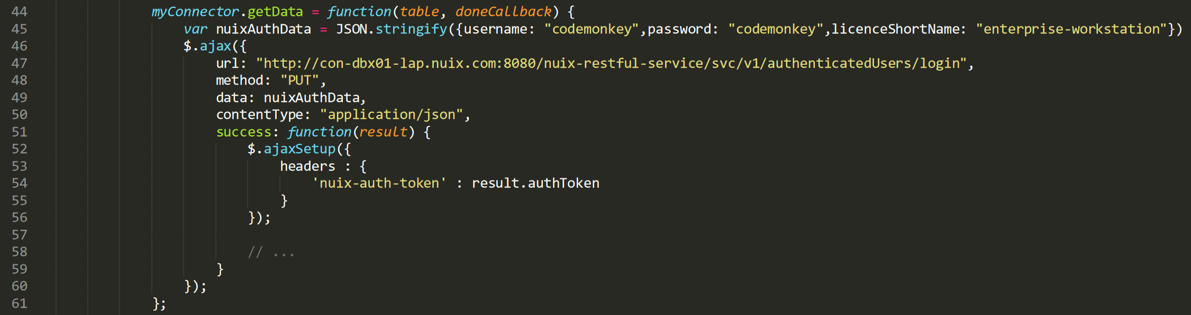
Authentication
These are not the droids you’re looking for…
…Clearly not a best practice

Slide 17
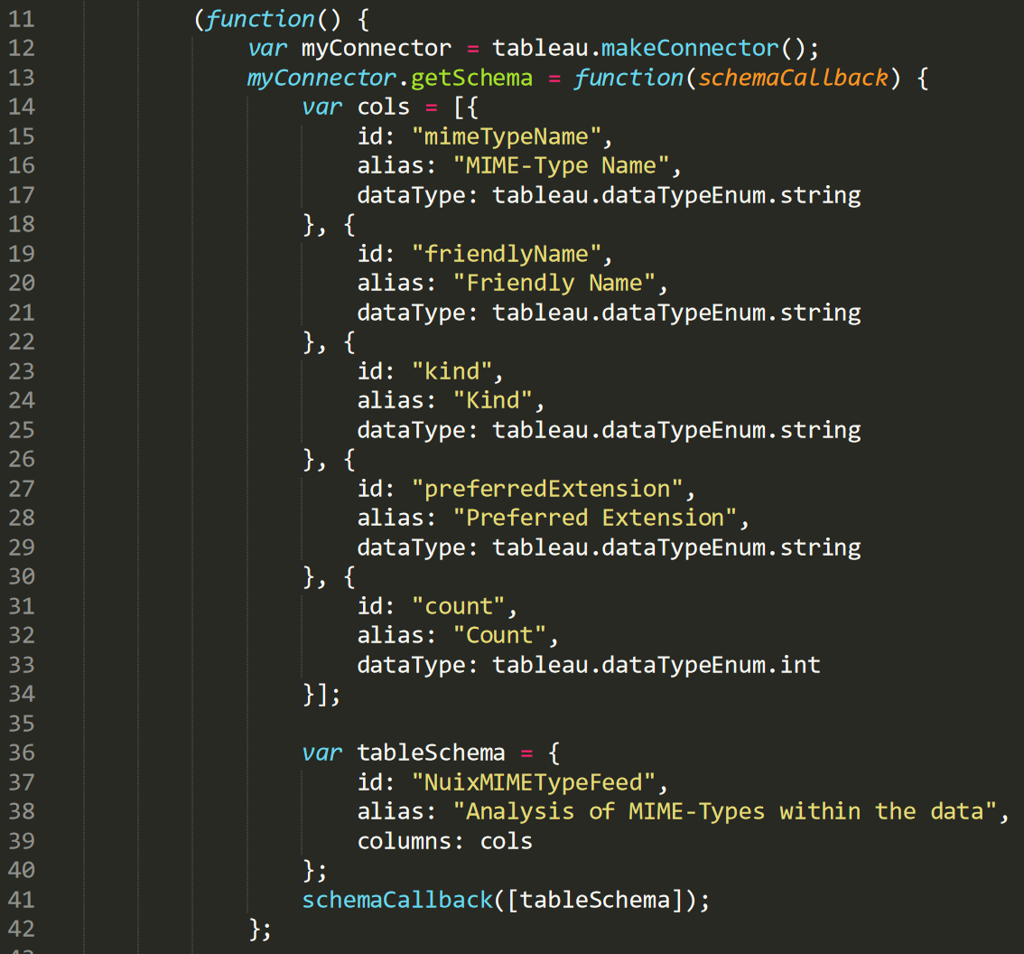
Create a Tableau Connector & Define a Schema
Work backwards from your optimal report

Slide 18
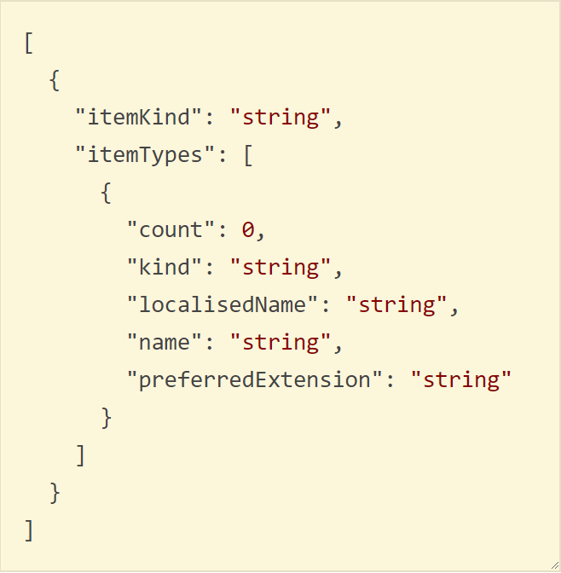
Create a Tableau Connector & Define a Schema
Uh oh…

Slide 19
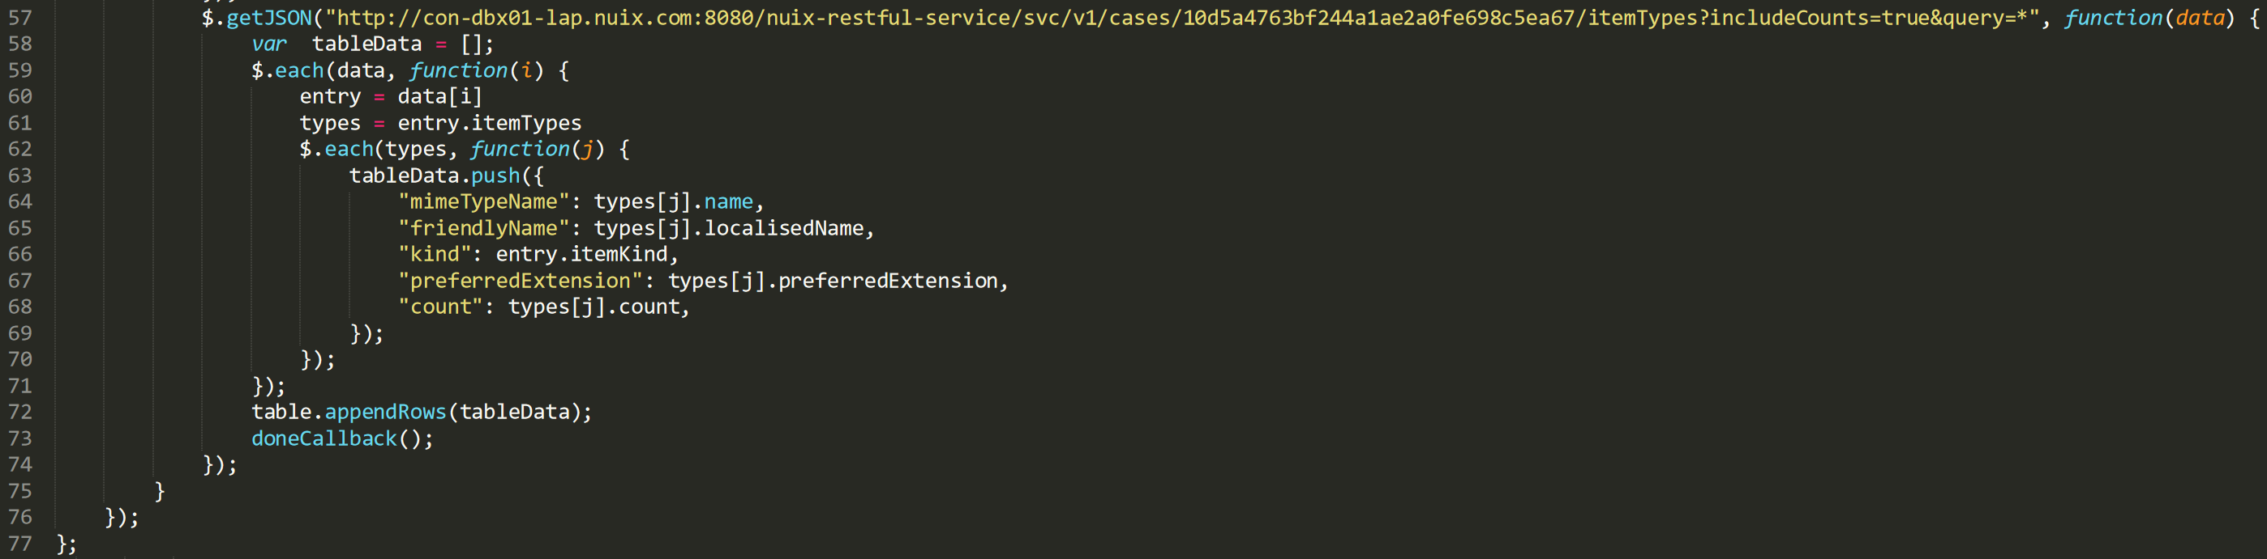
Field Mapping
Putting the ‘T’ in ETL

Slide 20
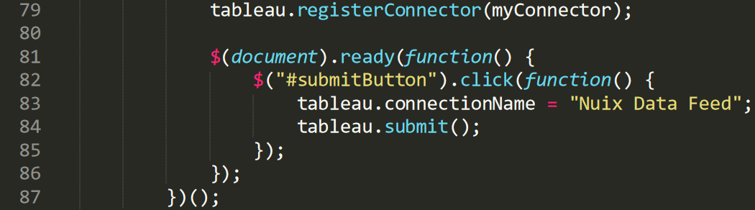
Register & Run
Here we go

Slide 21
Exercise Summary
A little after action review
Exactly 100 total lines (HTML/JavaScript) for the entire demo
The HTML file was deployed to the Nuix REST Tomcat instance so a separate web or application server is optional
This exercise demonstrated use of the /v1/cases/<case-guid>/itemTypes endpoint

Slide 22
End to End
Let’s take a step back…
Raw Data
Normalized Data
Schema Optimized Data
Killer Reports, Visualizations & Dashboards

Slide 23
Beneficial Capabilities
What features of this add value and how?
No additional software costs above existing Nuix license
Non-technical users are enabled to create their own reports, visualizations and dashboards
The ability to host your data locally or remotely
A mechanism for insulating your business users from technical complexity
An effective data transformation layer to support schema normalization
A reasonably low learning curve
Few dependencies
Tableau & others provides excellent developer documentation & tutorials

Slide 24
Additional Notes
What else should I know about this technique?
This is a custom approach that you can use today
Nuix is actively working to improve our integration with industry leading reporting platforms, not just Tableau
Web Data Connectors (WDC) can be can be implemented using:
Nuix REST API
Nuix IMS if you’re also using Web Review
Nuix’s Native APIs (Java, JRuby, ECMAScript & Jython)
Your Custom Source

Slide 25
Summary
What would I like you to take away from this presentation?
Reporting can quickly become unmanageable w/o a well planned approach from data acquisition to disposition
Your organization can benefit from:
Understanding the schema of your source data (Nuix the crap out of it!)
Normalization of that data in Nuix
Culling, enrichment & transformation capabilities
Multiple ways to move optimized data sets to your reporting platform

Slide 26
Summary
What would I like you to take away from this presentation?
Work from both the left and the right
Data hygiene is key
Decouple data schema and report design
Lead with user experience

Slide 27
So Reporting is “Solved” ?
Hardly. This is a powerful technique but what challenges remain?
Optimized schemas can take some work
Reports, visualizations and dashboards all have to be designed and well aligned to a schema
Insights gained from reporting are dependent on the quality and clarity the presented data as well as the perception of the report reader
Additional analytical & graphing capabilities may be needed to draw connections in complex data sets

Slide 28
Questions & Group Discussion
Could this approach benefit your work?
?

